Slide 1
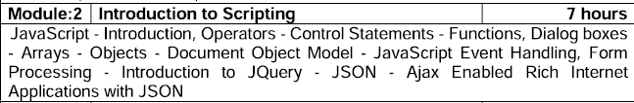

Slide 2
Java Script – Introduction
JavaScript is a lightweight, interpreted programming language. It is designed for creating network-centric applications. JavaScript allows you to add interactivity to a web page. It is often used with HTML and CSS to enhance the functionality of a web page such as validating forms, creating interactive maps, and displaying animated charts.
When a web page is loaded i.e. after HTML and CSS have been downloaded, the JavaScript engine in the web browser executes the JavaScript code. The JavaScript code then modifies the HTML and CSS to dynamically update the user interface.
Client-side JavaScript is the most common form of the language. The script should be included in or referenced by an HTML document for the code to be interpreted by the browser.

Slide 3
Java Script – Introduction
Advantages:
Less server interaction
Immediate feedback to the visitors
Increased interactivity
Richer interfaces
Limitations:
Client-side JavaScript does not allow the reading or writing of files. This has been kept for security reason.
JavaScript cannot be used for networking applications because there is no such support available.
JavaScript doesn’t have any multi-threading or multiprocessor capabilities.
So that, JavaScript cannot be treated as a full-fledged programming language

Slide 4
History & need
JavaScript was invented by Brendan Eich at Netscape (with Navigator 2.0) and has appeared in all browsers since 1996.
The official standardization was adopted by the ECMA organization in 1997
ECMA-262 is the official JavaScript standard
JavaScript was designed to add interactivity to HTML pages
JavaScript is a Scripting language.
A scripting language is a light weight programming language
JavaScript is usually embedded directly into HTML pages
JavaScript is an interpreted language (means that scripts execute without preliminary compilation)
Everyone can use JavaScript without purchasing a license

Slide 5
Java Script – Introduction
JavaScript can be implemented using JavaScript statements that are placed within the <script>... </script> HTML tags in a web page. The syntax is:
<script language = "javascript" type = "text/javascript"> JavaScript code
</script>
Language − This attribute specifies what scripting language has used. Typically, its value will be JavaScript.
Type − This attribute is recommended to indicate the scripting language in use and its value should be set to "text/javascript".
Src – This attribute is required when script has to be included as external file.

Slide 6
Java Script – Introduction
There is a flexibility given to include JavaScript code anywhere in an HTML document. However the most preferred ways to include JavaScript is in <head> section .
To use JavaScript from an external file source, you need to write all your JavaScript source code in a simple text file with the extension ".js" and then include that file in src attribute as follows:
<script type = "text/javascript" src = "filename.js" >
</script>
JavaScript is a case-sensitive language.
Any text between a // and the end of a line is treated as a comment and is ignored by JavaScript.
Any text between the characters /* and */ is treated as a comment. This may span multiple lines.

Slide 7
Java Script – Data Types
One of the most fundamental characteristics of a programming language is the set of data types it supports.
JavaScript allows three primitive data types −
Numbers, eg. 123, 120.50 etc.
Strings of text e.g. "This text string" etc.
Boolean e.g. true or false.

Slide 8
Java Script – Variables
Variables can be thought of as named containers.
Variable must be declared before using that. Variables are declared with the var keyword.
Storing a value in a variable is called variable initialization. Variable initialization can be done at the time of variable creation or at a later point in time when it is needed.
Should not use any of the JavaScript reserved keywords as a variable name. For example, break or boolean variable names are not valid.
JavaScript variable names should not start with a numeral (0-9). They must begin with a letter or an underscore character. For example, 123test is an invalid variable name but _123test is a valid one.
JavaScript variable names are case-sensitive. For example, Name and name are two different variables.

Slide 9
Variables
A JavaScript variable is simply a name of storage location. There are two types of variables in JavaScript : local variable and global variable.
Rules for declaring:
Name must start with a letter (a to z or A to Z), underscore( _ ), or dollar( $ ) sign.(Ex. Variable name ‘123college’ is invalid, _123college is valid)
After first letter we can use digits (0 to 9), for example value1.
JavaScript variables are case sensitive, for example x and X are different variables.
Var a= 10;//hold number
Var b=“VLR”; //hold string
Variables are declared using ‘var’

Slide 10
Variables
Local Variables | Global Variables
A JavaScript local variable is declared inside block or function. It is accessible within the function or block only | A variable i.e. declared outside the function or declared with window object is known as global variable.
<script> function abc(){ var x=10;//local variable } </script> | <script> var data=200;//global variable function a(){ document.write(data); } </script>

Slide 11
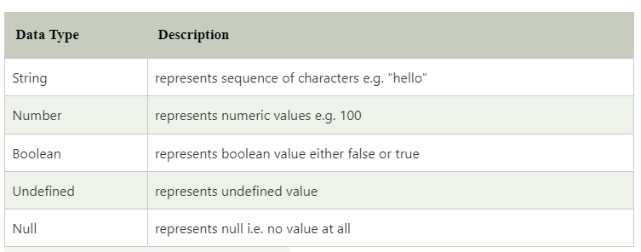
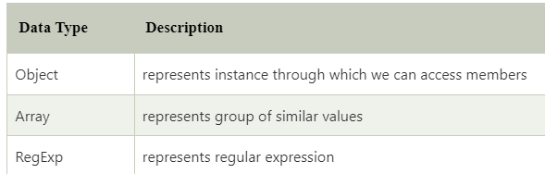
Datatypes
JavaScript is a dynamic type language, means you don't need to specify type of the variable because it is dynamically used by JavaScript engine
JavaScript provides different data types to hold different types of values. There are two types of data types in JavaScript.
Primitive Data Type | Non Primitive Data Type

Slide 12
Primitive data type
Numbers - A number can be either an integer or a decimal
Strings - A string is a sequence of letters or numbers enclosed in single or double quotes
Boolean - True or False
Undefined - A variable without a value, has the value undefined.
Null - In JavaScript null is "nothing".
In JavaScript, the data type of null is an object.

Slide 13
Non Primitive data type
Object
Unordered collection of properties
Name:value pairs
var student={name:”Arun”,regno:”21BIT001” ,cgpa:9.2};
a = student.regno (or) a= student[“regno”]
Arrays
Collection of values in a single variable
var fruits = [ “apple”,”orange”,”mango”] or var num=[1,2,3]
Dynamic data types – same variable can be used for different types
var x=5;
var x=“Hai”;

Slide 14
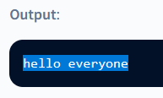
To display a simple string:
<!doctype html>
<html>
<head> <title>hello, world!</title> </head>
<body>
<script type="text/javascript">
document.write("hello everyone");
</script>
</body>
</html>

Slide 15
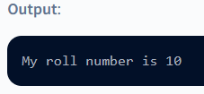
concatenate strings
We can concatenate strings and display them as a single string:
<!DOCTYPE html>
<html>
<head> <title>Hello, World!</title>
</head> <body>
<script type="text/javascript">
document.write("My roll number is " +10);
</script> </body> </html>

Slide 16
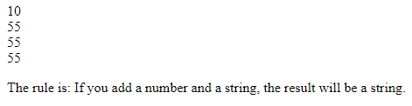

Expression demo
<html>
<body>
<script type="text/javascript">
var x;
x=5+5;
document.write(x); document.write("<br />"); x="5"+"5";
document.write(x); document.write("<br />"); x=5+"5";
document.write(x); document.write("<br />"); x="5"+5;
document.write(x); document.write("<br />");
</script>
<p>The rule is: If you add a number and a string, the result will be a string.</p>
</body>
</html>

Slide 17
Popup boxes – Prompt
A prompt box is often used if you want the user to input a value before entering a page.
The user will have to click either "OK" or "Cancel“ after entering an input value.
"OK“ - returns the input value.
"Cancel“ - returns null.
🠶 When a prompt box pops up, the user will have to click either "OK" or "Cancel" to proceed after entering an input value.
🠶 If the user clicks "OK" the box returns the input value. If the user clicks "Cancel" the box returns null.
<script>
x=prompt (“Enter ur name”, “ ”)
alert(“Good Morning “+x)
</script>

Slide 18
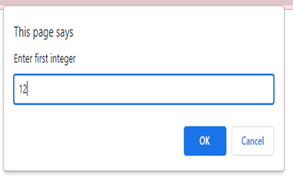
prompt
<html>
<head>
<title>Using Prompt and Alert Boxes</title>
<script type = "text/javascript">
var firstNumber, secondNumber, number1, number2, sum; firstNumber = window.prompt( "Enter first integer", "0" );
secondNumber =window.prompt( "Enter second integer", "0" );
// convert numbers from strings to integers number1 = parseInt( firstNumber ); number2 = parseInt( secondNumber ); sum = number1 + number2;
document.writeln( "<h1>The sum is " + sum + "</h1>" );
</script>
</head>
<body></body>
</html>

Slide 19
Popup boxes – Alert
An alert box is often used if you want to make sure information comes through to the user.
When an alert box pops up, the user will have to click "OK" to proceed.
<script>
alert(“Good Morning!")
</script>

Slide 20
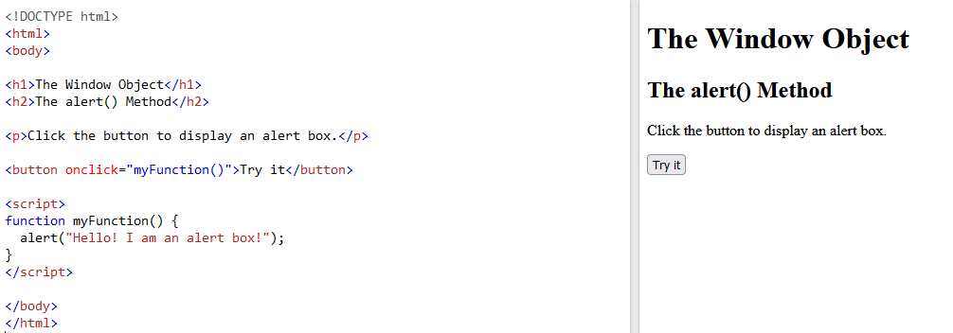
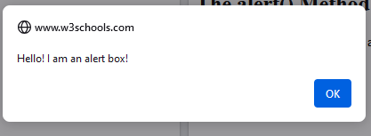
alert

Slide 21
Popup boxes – Confirm
A confirm box is often used if you want the user to verify or accept something.
The user will have to click either "OK" or "Cancel“.
If the user clicks "OK", the box returns true. If the user clicks "Cancel", the box returns false.
<!DOCTYPE html>
<html>
<body>
<h1>The Window Object</h1>
<h2>The confirm() Method</h2>
<p>Click the button to display a confirm box.</p>
<button onclick="myFunction()">Try it</button>
<script>
function myFunction() {
confirm("Press a button!");
}
</script>
</body>
</html>
<script>
x=confirm (“Are you sure you want to delete ?”)
</script>

Slide 22
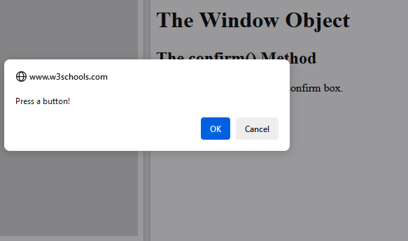
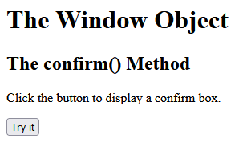
confirm

Slide 23
Java Script – Operators
Operator is used to apply some process over operands. E.g., 4+5, here 4 and 5 are operands, "+" is the operator. Types of operators are:
Arithmetic Operators
Relational Operators
Logical Operators
Assignment Operators
Conditional (or ternary) Operators

Slide 24
Java Script – Arithmetic Operators
Operator | Purpose | Example
+ (Addition) | Adds two operands | A + B => 8
- (Subtraction) | Subtracts the second operand from the first | A – B => 2
* (Multiplication) | Multiply both operands | A * B => 15
/ (Division) | Divide the numerator by the denominator | A / B => 1
% (Modulus) | Outputs the remainder of an integer division | A % B => 2
++ (Increment) | Increases an integer value by one | A++ => 6
-- (Decrement) | Decreases an integer value by one | A – – => 4
Here A has 5 and B has 3

Slide 25
Java Script – Relational Operators
Operator | Purpose | Example
== (Equals) | Checks if the value of two operands are equal or not, if yes, then the condition becomes true. | A == B => False
!= (Not Equals) | Checks if the value of two operands are equal or not, if the values are not equal, then the condition becomes true. | A != B => True
> (Greater than) | Checks if the value of the left operand is greater than the value of the right operand, if yes, then the condition becomes true. | A > B => True
< (Less than) | Checks if the value of the left operand is less than the value of the right operand, if yes, then the condition becomes true. | A < B => False
>= (Greater than or Equal to) | Checks if the value of the left operand is greater than or equal to the value of the right operand, if yes, then the condition becomes true | A >= B => True
<= (Less than or Equal to) | Checks if the value of the left operand is less than or equal to the value of the right operand, if yes, then the condition becomes true. | A <= B => False
Here A has 5 and B has 3

Slide 26
Java Script – Logical Operators
Operator | Purpose | Example
&& (and) | If both the operands are non-zero, then the condition becomes true | A && B => True (A > B) &&(A>C) => True (C >A) && (C>B) => False
|| (or) | If any of the two operands are non-zero, then the condition becomes true | A || B => True (A > B) || (A>C) => True (C >A) || (C>B) => True
! (Logical NOT) | Reverses the logical state of its operand. If a condition is true, then the Logical NOT operator will make it false. | !A => False !(A > B) => False !(C > A) => True
Here A has 5 , B has 3 and C has 4

Slide 27
Java Script – Assignment Operators
Operator | Purpose | Example
= (Simple Assignment) | Assigns values from the right side operand to the left side operand | C = A + B
+=(Add and Assignment) | It adds the right operand to the left operand and assigns the result to the left operand. | A = A+ B => A += B
−= (Subtract and Assignment) | It subtracts the right operand from the left operand and assigns the result to the left operand. | A = A - B => A -= B
*= (Multiply and Assignment) | It multiplies the right operand with the left operand and assigns the result to the left operand. | A = A* B => A *= B
/= (Divide and Assignment) | It divides the left operand with the right operand and assigns the result to the left operand. | A = A/ B => A /= B
%= (Modules and Assignment) | It takes modulus using two operands and assigns the result to the left operand. | A = A% B => A %= B

Slide 28
Java Script – Miscellaneous Operators
Operator | Purpose | Example
Conditional Operator (? :) | The conditional operator first evaluates an expression for a true or false value and then executes one of the two given statements depending upon the result of the evaluation. | Max =(A>B) ? A:B
typeof() | The typeof operator is a unary operator that is placed before its single operand, which can be of any type. Its value is a string indicating the data type of the operand. | var A=20; var name="java"; typeof(A) => number typeof(name) => string
// Type conversion is performed before comparison
var v1 = ("5" == 5); // true
// No implicit type conversion.
// True if only if both types and values are equal
var v2 = ("5" === 5);// false
var v3 = (5 === 5.0); // true var v4 = (true == 1); // true (true is converted to 1)
var v5 = (true == 2); // false (true is converted to 1)
var v6 = (true == "1") // true

Slide 29
Java Script – Conditional & Branching
conditional statements allow the program to make correct decisions and perform right actions when it is required.
JavaScript supports the following forms of conditional and branching statement:
if statement
if...else statement
if...else if... statement
switch statement

Slide 30
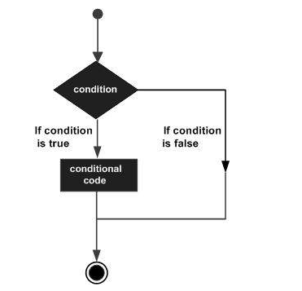
Java Script – if … else statement
The if statement can be used to execute a block of JavaScript code for the given condition is true. if statement has additional part "else"; so that, it can execute another block of code for the given condition is false. "else" is an optional part.
Syntax:
if (condition) { block of code to be executed if the condition is true }
else
{
block of code to be executed if the condition is false }
Example 1:
var age=12;
if (age < 18)
category="Minor";
Example 2:
var a=10;
var b=5;
var max;
if(a > b)
max = a;
else
max = b;
Conditional code

Slide 31
Java Script – if…else nested
The if...else if... statement is an advanced form of if…else that allows JavaScript to make a correct decision out of several conditions.
Syntax:
if (expression 1) {
Statement(s) to be executed if expression 1 is true }
else if (expression 2) {
Statement(s) to be executed if expression 2 is true }
else if (expression 3) {
Statement(s) to be executed if expression 3 is true }
else {
Statement(s) to be executed if no expression is true }
It is just a series of if statements, where each if is a part of the else clause of the previous statement. Statement(s) are executed based on the true condition, if none of the conditions is true, then the else block is executed

Slide 32
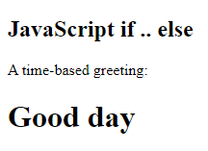
Java Script – if…else nested
Example:
var size = "S";
if( size == "S" ) { document.write("Size is Small"); }
else if( size == "M" ) { document.write("Size is Medium"); }
else if( size == "L" ) { document.write("Size is Large"); }
else { document.write("Size is above Large"); }
<!DOCTYPE html>
<html>
<body>
<h2>JavaScript if .. else</h2>
<p>A time-based greeting:</p>
<script>
const time = new Date().getHours(); let greeting;
if (time < 10) {
greeting = "Good morning";
} else if (time < 20) { greeting = "Good day";
} else {
greeting = "Good evening";
}
document.write("<h1>" + greeting + "</h1>");
</script>
</body>
</html>

Slide 33
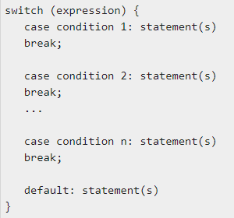
Java Script – Switch …. Case Statement
The objective of a switch statement is to give an expression to evaluate and several different statements to execute based on the value of the expression.
The interpreter checks each case against the value of the expression until a match is found. If nothing matches, a default condition will be used.
The break statements indicate the end of a particular case. If they were omitted, the interpreter would continue executing each statement in each of the following cases.

Slide 34
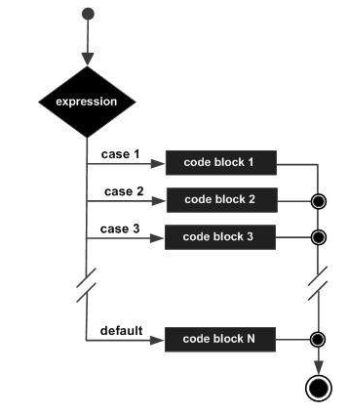
Java Script – Switch … Case Statement
Example:
var day="wed";
switch (day) {
case "mon": document.write("Day is Monday"); break;
case "tue": document.write("Day is Tuesday"); break;
case “wed": document.write("Day is Wednesday");
break;
case “thu": document.write("Day is Thursday"); break;
case “fri": document.write("Day is Friday"); break;
case “sat": document.write("Day is Saturday"); break;
case “sun": document.write("Day is Sunday"); break;
default: document.write("Unknown day"); }

Slide 35
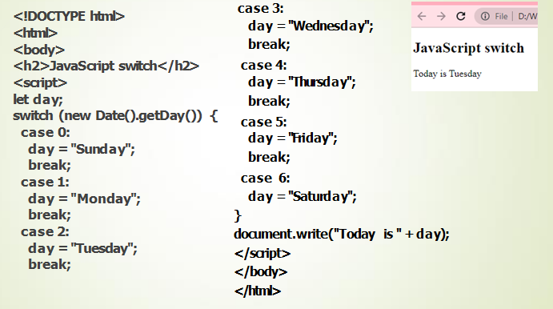
Switch case demo
new Date() returns the date based on the input parameter and Date() returns todays date on the browser.

Slide 36
Java Script – Conditional and Looping Statement
Conditional and looping is similar to branching statement but the difference is the block has repeated till the condition is true. This has classified into three categories:
while loop
do…while loop
for loop
🠶 Loops can execute a block of code a number of times.
🠶 JavaScript supports different kinds of loops:
for - loops through a block of code a number of times
for/in - loops through the properties of an object
for/of - loops through the values of an iterable object
while - loops through a block of code while a specified condition is true
do/while - also loops through a block of code while a specified condition is true

Slide 37
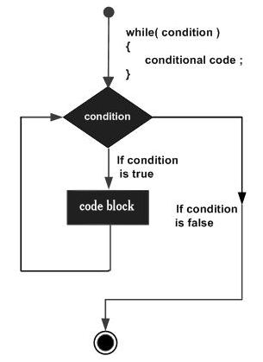
Java Script – While … Loop
The purpose of a while loop is to execute a statement or code block repeatedly as long as an expression is true. Once the expression becomes false, the loop terminates.
Syntax:
while (expression) {
Statement(s) to be executed if expression is true }
Example:
var count = 0; document.write("Starting Loop "); while (count < 10) { document.write("Current Count : " + count + "<br>“);
count++;
}

Slide 38
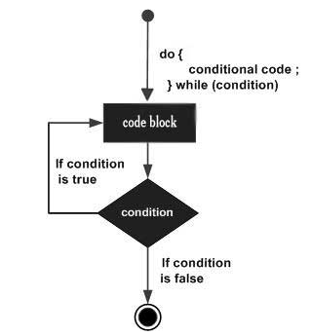
Java Script – do..while loop
The do...while loop is similar to the while loop except that the condition check happens at the end of the loop. This means that the loop will always be executed at least once, even if the condition is false.
Syntax:
do {
Statement(s) to be executed;
} while (expression);
Example:
var count = 0;
document.write("Starting Loop" + "<br />");
do {
document.write("Current Count : " + count + "<br />");
count++; }
while(count <5);

Slide 39
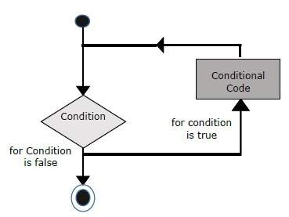
Java Script – for loop
The 'for' loop is the most compact form of looping. It includes the following three important parts −
The loop initialization where we initialize our counter to a starting value. The initialization statement is executed before the loop begins.
The test statement which will test if a given condition is true or not. If the condition is true, then the code given inside the loop will be executed, otherwise the control will come out of the loop.
The iteration statement where you can increase or decrease your counter.

Slide 40
Java Script – for loop
Syntax:
for (initialization; test condition; iteration statement) { Statement(s) to be executed if test condition is true }
Example:
var count;
document.write("Starting Loop" + "<br />"); for(count = 0; count < 10; count++) { document.write("Current Count : " + count ); document.write("<br />");
}

Slide 41
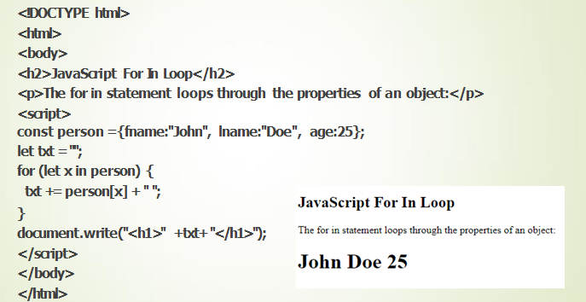
For In Loop
The JavaScript for in statement loops through the properties of an Object
for (key in object) {
// code block to be executed
}

Slide 42
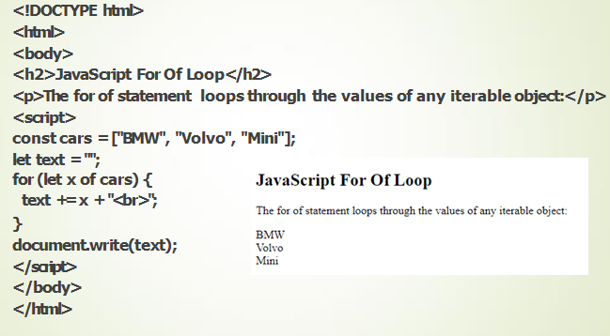
For of loop
The JavaScript for of statement loops through the values of an iterable object.
It lets you loop over iterable data structures such as Arrays, strings, etc
for (variable of iterable) {
// code block to be executed
}

Slide 43
Difference between for...of and for...in
The main difference between them is in what they iterate over.
The for...in statement iterates over the enumerable string properties of an object,
while the for...of statement iterates over values that the iterable object defines to be iterated over.

Slide 44
Control Statements -Examples
const num = 5;
if (num > 0) {
console.log("The number is positive.");
};

Slide 45
let num = -10;
if (num > 0)
console.log("The number is positive.");
else
console.log("The number is negative");

Slide 46
// Program to check if the number is positive
const number = prompt("Enter a number: ");
// check if number is greater than 0
if (number > 0) {
// the body of the if statement
console.log("positive number");
}
console.log("nice number");

Slide 47
let num = 5;
switch (num) {
case 0:
console.log("Number is zero.");
break;
case 1:
console.log("Nuber is one.");
break;
case 2:
console.log("Number is two.");
break;
default:
console.log("Number is greater than 2.");
};

Slide 48
// Program to print the value of i
for (let i = 1; i <= 5; i++) {
// break condition
if (i == 3) {
break;
}
console.log(i);
}

Slide 49
let sum = 0;
// infinite loop
while (true) {
// get number input
let num = Number(prompt("Enter a number: "));
// terminate the loop if num is negative
if (num < 0)
break;
}
// otherwise, add num to sum
else {
sum += num;
}
}
// print the sum
console.log(`Sum: ${sum}`);

Slide 50
JavaScript Explicit Conversion
let result;
// convert string to number
result = Number("5");
console.log(result, "-", typeof(result));
// convert boolean to string
result = String(true);
console.log(result, "-", typeof(result));
// convert number to boolean
result = Boolean(0);
console.log(result, "-", typeof(result));

Slide 51

Java Script – Functions
A function is a group of reusable code which can be called anywhere in the program. This eliminates the need of writing the same code again and again.
Definition – The most common way to define a function in JavaScript is by using the function keyword, followed by a unique function name, a list of parameters (that might be empty), and a statement block surrounded by curly braces.
Calling – To invoke a function somewhere later in the script, it should be called by writing the name of that function with () and arguments if any.
Return – A JavaScript function can have an optional return statement. This is required when return a value from the function. This statement should be the last statement in a function.
Syntax:
function functionname(parameter-list) {
statements
}
Mon Sep 02 2024 10:47:07 GMT+0530 (India Standard Time)

Slide 52
Java Script – Functions
Parameters
function sayHello(name, age) {
document.write (" name: " + name);
document.write(“Age is: " + age);
}
…………
…………
…………
<input type = "button" onclick = "sayHello('Zara', 7)" value = "Say Hello">
Function Definition
Arguments
Function Calling

Slide 53
Java Script – Functions
Function parameters are listed inside the parentheses () in the function definition.
Function arguments are the values received by the function when it is invoked.
Inside the function, the arguments (the parameters) behave as local variables.

Slide 54
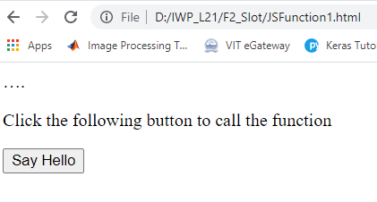
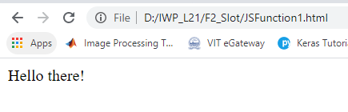
Java Script – Simple Function Example
<html>
<script type = "text/javascript">
function sayHello() {
document.write ("Hello there!");
}
</script>
<body>
<p>Click the following button to call the function
</p>
<form>
<input type = "button" onclick = "sayHello()" value = "Say Hello">
</form> </body>
</html>

Slide 55
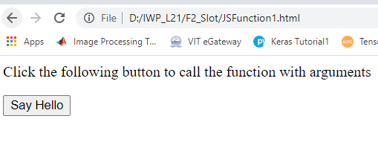
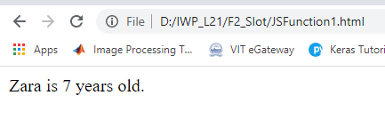
Java Script – Function with Parameters
<html> <head>
<script type = "text/javascript">
function sayHello(name, age) { document.write (name + " is " + age + " years old.");
}
</script>
</head>
<body>
<p>Click the following button to call the function</p>
<form>
<input type = "button" onclick = "sayHello('Zara', 7)" value = "Say Hello"> </form>
</body> </html>

Slide 56
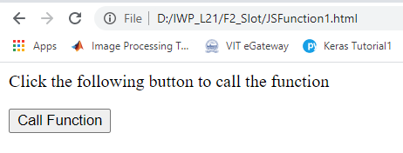
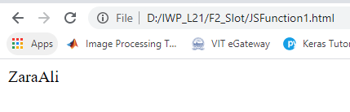
Java Script – Function with return
<html> <head>
<script type = "text/javascript">
function concatenate(first, last) {
var full;
full = first + last;
return full; }
function secondFunction() {
var result;
result = concatenate('Zara', 'Ali'); document.write (result );
}
</script>
</head> <body>
<p>Click the following button to call the function</p>
<form>
<input type = "button" onclick = "secondFunction()" value = "Call Function"> </form>
</body> </html>

Slide 57
Java Script – Arrays
An array is a special variable, which can hold more than one value at a time. It stores a fixed-size sequential collection of elements.
var array_name = [item1, item2, ...];
Using an array literal is the easiest way to create a JavaScript Array.
var cars = ["Saab", "Volvo", "BMW"];
Access an array element by referring to the index number.
var name = cars[0];
Cars[0] = “Ambassdor”
Arrays are treated as objects; Objects use names to access its "members“.
var array_object = {key1:value1, key 2:value2,… key n:valuen}
var person = {firstName:"John", lastName:"Doe", age:46};

Slide 58
Java Script – Array Properties
The length property of an array returns the length of an array
var fruits = ["Banana", "Orange", "Apple", "Mango"];
var arraySize = fruits.length;
document.write(“The array size is “+arraySize);

Slide 59
Java Script – Array Methods
Method | Description
arrayX = Array1.concat(array2 [, array3,..]) | Returns a new array comprised of this array joined with other array(s) and/or value(s).
intVar = Array.indexOf(value) | Returns the first (least) index of an element within the array equal to the specified value, or -1 if none is found.
Str1 = Array.join() | Joins all elements of an array into a string.
intVar = lastIndexOf(value) | Returns the last (greatest) index of an element within the array equal to the specified value, or -1 if none is found.
Var1 = array.pop() | Removes the last element from an array and returns that element.
Array.push(val1[,val2, ..]) | Adds one or more elements to the end of an array and returns the new length of the array.

Slide 60
Java Script – Array Methods
Method | Description
newArray = array.reverse() | Reverses the order of the elements of an array -- the first becomes the last, and the last becomes the first.
Var1 = array.shift() | Removes the first element from an array and returns that element.
newArray = array.slice(start, end) | Extracts a section of an array and returns a new array.
Array.sort() | Sorts the elements of an array
Array.splice(index, howmany, newitem1,newitem2,…) | Adds and/or removes elements from an array.
stringvar = array.toString() | Returns a string representing the array and its elements.
Array.unshift(val1[,val2,…]) | Adds one or more elements to the front of an array and returns the new length of the array.

Slide 61
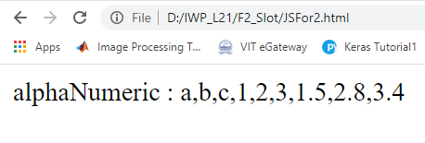
Java Script – concat()
<html>
<script type = "text/javascript">
var alpha = ["a", "b", "c"];
var numeric = [1, 2, 3];
var floatvalues= [1.5, 2.8, 3.4];
var alphaNumeric = alpha.concat(numeric, floatValues);
document.write("alphaNumeric : " + alphaNumeric );
</script>
</html>

Slide 62
Java Script – Introduction
array.indexOf(searchElement[, fromIndex]);
Returns the index of the found element.
searchElement − Element to locate in the array.
fromIndex − The index at which to begin the search. Defaults to 0, i.e. the whole array will be searched. If the index is greater than or equal to the length of the array, -1 is returned.
var array1= [12, 5, 8, 130, 44]
var ind2 = array1.indexOf(8); document.write("index of 8 is: " + ind2 );
ind1 = array1.indexOf(13); document.write("<br />index of 13 is : " + ind1);
- returns the position of the first occurrence of a value in a string.
The indexOf() method returns -1 if the value is not found.

Slide 63
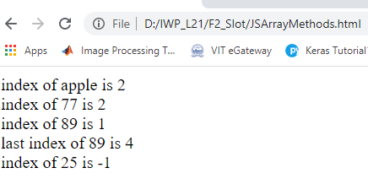
Java Script – indexOf & lastIndexOf
<script>
var fruits = ["Banana", "Orange", "Apple", "Mango"];
var marks =[67,89,77,80,89,78,60];
var a = fruits.indexOf("Apple");
document.write(“index of apple is “+a+”<br>”);
document.write(“index of 77 is “+ marks.indexOf(77)+”<br>”);
document.write(“index of 89 is “+ marks.indexOf(89)+”<br>”);
document.write(“last index of 89 is “+ marks.lastIndexOf(89)+”<br>”);
</script>

Slide 64
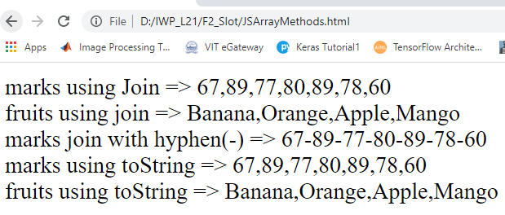
Java Script – join and toString
<script>
var fruits = ["Banana", "Orange", "Apple", "Mango"];
var marks =[67,89,77,80,89,78,60];
var marksJoin = marks.join();
var fruitsJoin = fruits.join();
var marksJoinHyphen = marks.join("-");
var marksToString = marks.toString();
var fruitsToString = fruits.toString();
document.write("marks using Join => "+marksJoin+"<br>");
document.write("fruits using join => "+fruitsJoin+"<br>");
document.write("marks join with hyphen(-) => "+marksJoinHyphen+"<br>");
document.write("marks using toString => "+marksToString+"<br>");
document.write("fruits using toString => "+fruitsToString+"<br>");
</script>
The toString() method returns a string as a string.
The toString() method does not change the original string.

Slide 65
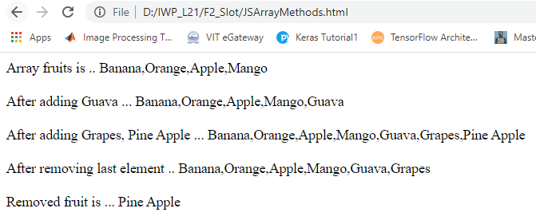
Java Script – push & pop
<script>
var fruits = ["Banana", "Orange", "Apple", "Mango"];
document.write("Array fruits is .. "+fruits+"<br><br>");
fruits.push("Guava");
document.write("After adding Guava ... "+fruits+"<br><br>");
fruits.push("Grapes","Pine Apple");
document.write("After adding Grapes, Pine Apple ... "+fruits+"<br><br>");
var popFruit = fruits.pop();
document.write("After removing last element .. "+fruits+"<br><br>");
document.write("Removed fruit is ... "+ popFruit+"<b>");
</script>

Slide 66
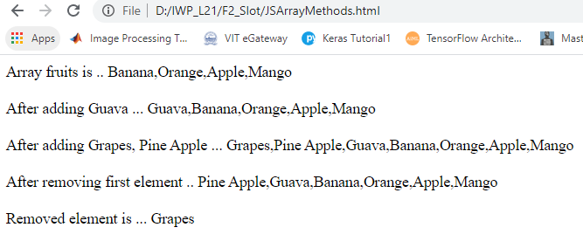
Java Script – unshift & shift
<script>
var fruits = ["Banana", "Orange", "Apple", "Mango"];
document.write("Array fruits is .. "+fruits+"<br><br>");
fruits.unshift("Guava");
document.write("After adding Guava ... "+fruits+"<br><br>");
fruits.unshift("Grapes","Pine Apple");
document.write("After adding Grapes, Pine Apple ... "+fruits+"<br><br>");
var popFruit = fruits.shift();
document.write("After removing first element .. "+fruits+"<br><br>");
document.write("Removed element is ... "+ popFruit+"<b>"); </script>

Slide 67
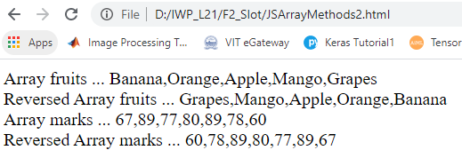
Java Script – reverse
<script>
var fruits = ["Banana", "Orange", "Apple", "Mango","Grapes"];
var marks =[67,89,77,80,89,78,60];
document.write("Array fruits ... "+ fruits+"<br>");
fruits.reverse();
document.write("Reversed Array fruits ... "+ fruits+"<br>");
document.write("Array marks ... "+ marks+"<br>");
marks.reverse();
document.write("Reversed Array marks ... "+ marks+"<br>");
</script>

Slide 68
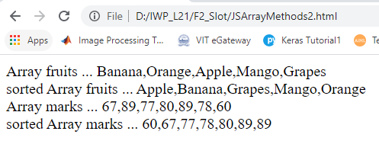
Java Script – sort
<script>
var fruits = ["Banana", "Orange", "Apple", "Mango","Grapes"];
var marks =[67,89,77,80,89,78,60];
document.write("Array fruits ... "+ fruits+"<br>");
fruits.sort();
document.write("sorted Array fruits ... "+ fruits+"<br>");
document.write("Array marks ... "+ marks+"<br>");
marks.sort();
document.write("sorted Array marks ... "+ marks+"<br>");
</script>

Slide 69
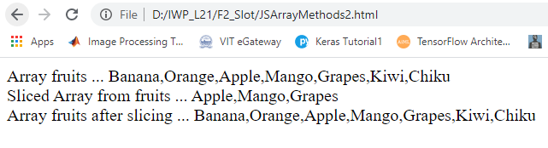
Java Script – slice
<script>
var fruits = ["Banana", "Orange", "Apple", "Mango","Grapes","Kiwi","Chiku"];
document.write("Array fruits ... "+ fruits+"<br>");
var slicedFruits = fruits.slice(2,5);
document.write("Sliced Array from fruits ... "+ slicedFruits+"<br>");
document.write("Array fruits after slicing ... "+ fruits+"<br>");
</script>
The slice() method returns selected elements in an array, as a new array.
The slice() method selects from a given start, up to a (not inclusive) given end.
The slice() method does not change the original array.

Slide 70
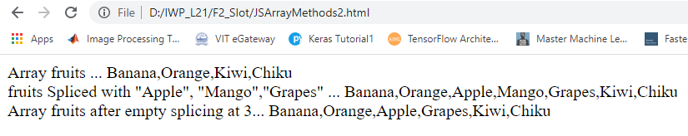
Java Script – splice
<script>
var fruits = ["Banana", "Orange", "Kiwi","Chiku"];
document.write("Array fruits ... "+ fruits+"<br>");
fruits.splice(2,0,"Apple", "Mango","Grapes");
document.write("fruits Spliced with \"Apple\", \"Mango\",\"Grapes\" ... "+ fruits+"<br>");
fruits.splice(3,1);
document.write("Array fruits after empty splicing at 3... "+ fruits+"<br>");
</script>

Slide 71
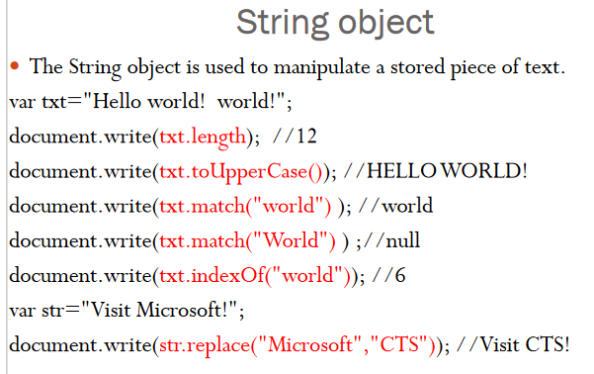

Slide 72
String Object & Methods
Methods
replace(exp [, replacement text]);
Search(expression)
Split(delimiter[,count]); // an array of substring
Substr(start[,length]) ;
toUpperCase()
toLowerCase();
name = “Hello World”;
message=name.replace(/World/,”VIT”); // Hello VIT
name = “Hello VIT”;
message=name.split(“ ”); // Hello, VIT
name = “Hello VIT”;
message=name.toLowerCase();

Slide 73
Array Object & Methods
Methods | Description
concat() | Joins two or more arrays, and returns a copy of the joined arrays
indexOf() | Search the array for an element and returns its position
join() | Joins all elements of an array into a string
lastIndexOf() | Search the array for an element, starting at the end, and returns its position
pop() | Removes the last element of an array, and returns that element
push() | Adds new elements to the end of an array, and returns the new length
reverse() | Reverses the order of the elements in an array
shift() | Removes the first element of an array, and returns that element
slice() | Selects a part of an array, and returns the new array
sort() | Sorts the elements of an array
splice() | Adds/Removes elements from an array
toString() | Converts an array to a string, and returns the result
unshift() | Adds new elements to the beginning of an array, and returns the new length
valueOf() | Returns the primitive value of an array

Slide 74
Math Object & Methods
Methods | Description
abs(x) | Returns the absolute value of x
ceil(x) | Returns x, rounded upwards to the nearest integer
cos(x) | Returns the cosine of x (x is in radians)
exp(x) | Returns the value of E^{x}
floor(x) | Returns x, rounded downwards to the nearest integer
log(x) | Returns the natural logarithm (base E) of x
max(x,y,z,...,n) | Returns the number with the highest value
min(x,y,z,...,n) | Returns the number with the lowest value
pow(x,y) | Returns the value of x to the power of y
random() | Returns a random number between 0 and 1
round(x) | Rounds x to the nearest integer
sin(x) | Returns the sine of x (x is in radians)
sqrt(x) | Returns the square root of x
tan(x) | Returns the tangent of an angle

Slide 75
Date Object
The Date object is used to work with dates and times.
Date objects are created with the Date() constructor.
new Date() // current date and time new Date(milliseconds) //milliseconds since 1970/01/01 new Date(yy,mm,dd) //with specified date new Date(yy,mm,dd,hh,mm,ss) //with specified date & time new Date(“Month dd,yyyy”) //datestring in the given format new Date(“Month dd,yyyy hh:mm:ss”) //datestring in the //given format
var today = new Date() var d1 = new Date("October 13, 1975 11:13:00") var d2 = new Date(13,5,24) var d3 = new Date(13,5,24,11,33,0)

Slide 76
Date Object-Methods
getFullYear() //4-digit year
getMonth() //(0-11 as Jan=0,feb=1…)
getDate() //(1-31)
getDay() //(0-6 as Sunday=0)
getHours //(0-23)
getMinutes //(0-59)
getSeconds //(0-59)
getMilliseconds //(0-999)
getTimezoneOffset //time diff between local PC and GMT

Slide 77
Current date and time
<script>
var currentDate = new Date()
var day = currentDate.getDate();
var month = currentDate.getMonth() + 1;
var year = currentDate.getFullYear();
var my_date = day+"-"+month+"-"+year;
document.write("Todays date is : "+my_date);
var hours = currentDate.getHours()
var minutes = currentDate.getMinutes()
if (minutes < 10){
minutes = "0" + minutes
}
document.write(hours + ":" + minutes + " ")
if(hours > 11){
document.write("PM")
} else {
document.write("AM")
}
</script>

Slide 78
Number Object & Methods
Property | Description
MAX_VALUE | Returns the largest number possible in JavaScript
MIN_VALUE | Returns the smallest number possible in JavaScript
NEGATIVE_INFINITY | Represents negative infinity (returned on overflow)
NaN | Represents a "Not-a-Number" value
POSITIVE_INFINITY | Represents infinity (returned on overflow)

Slide 79
Number Object & Methods
Methods | Description
toExponential(x) | Converts a number into an exponential notation
toFixed(x) | Formats a number with x numbers of digits after the decimal point
toPrecision(x) | Formats a number to x length
toString() | Converts a Number object to a string

Slide 80
Global Properties and methods
Global properties and functions can be used with all the built-in JavaScript objects.
Property | Description
Infinity | A numeric value that represents positive/negative infinity
NaN | "Not-a-Number" value
undefined | Indicates that a variable has not been assigned a value

